Slide 1


DATA MINING USING ORANGE TOOL
Prepaid by : Kashyap Shah(18DCE115)

Slide 2

OUTLINE
INTRODUCTION
WHY ORANGE TOOL?
FEATURES
IMPLIMETATION
REFERENCES

Slide 3
INTRODUCTION
Orange is an open-source data visualization, machine learning and data mining toolkit. It features a visual programming front-end for explorative rapid qualitative data analysis and interactive data visualization.
It is a group of python-based modules that exist in the core library.
Orange Widgets provide a graphic user interface to Orange data mining and machine learning methods.
Orange supports a flexible domain for developers, analysts, and data mining specialists.
Python, a new generation scripting language and programming environment, where our data mining scripts may be easy but powerful.
The operating principle of Orange is cover techniques and perspective in data mining and machine learning.

Slide 4
WHY ORANGE TOOL?
No Programming needed – Visual Programming
Data visualization
Easy to try different machine learning algorithms
Free and open source software

Slide 5
FEATURES
Open and free software : Orange is an open source data mining software tool.
Platform independent software: Orange is supported on various of Linux, Microsoft windows, Apple Mac.
Programming support: Orange support visual programming tools for data mining.
Scripting interface : Orange provides python scripting.
Orange provides various Widgets like Data, Visualize, Classify, Regression, etc.
Orange also provides different types of add-ons like Image Analytics, Text mining, Time Series, Geo, Educational, Networking, etc.

Slide 6
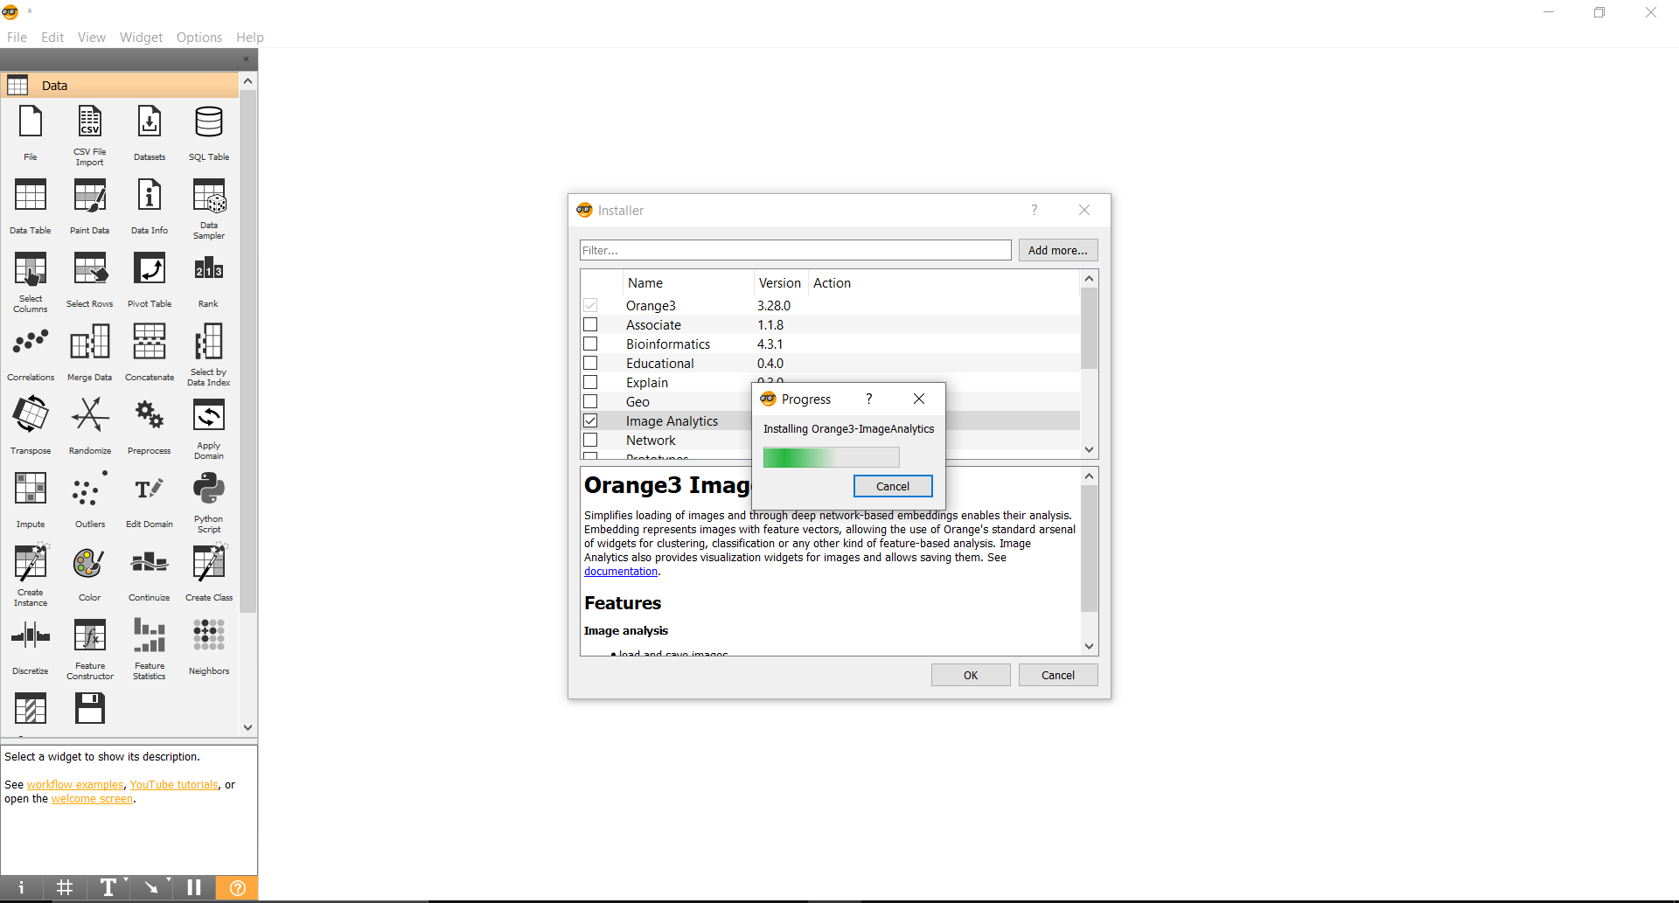
IMPLEMENTATION
First of all, to work with Images we have to install Image Analytics add-on in the Options.

Slide 7
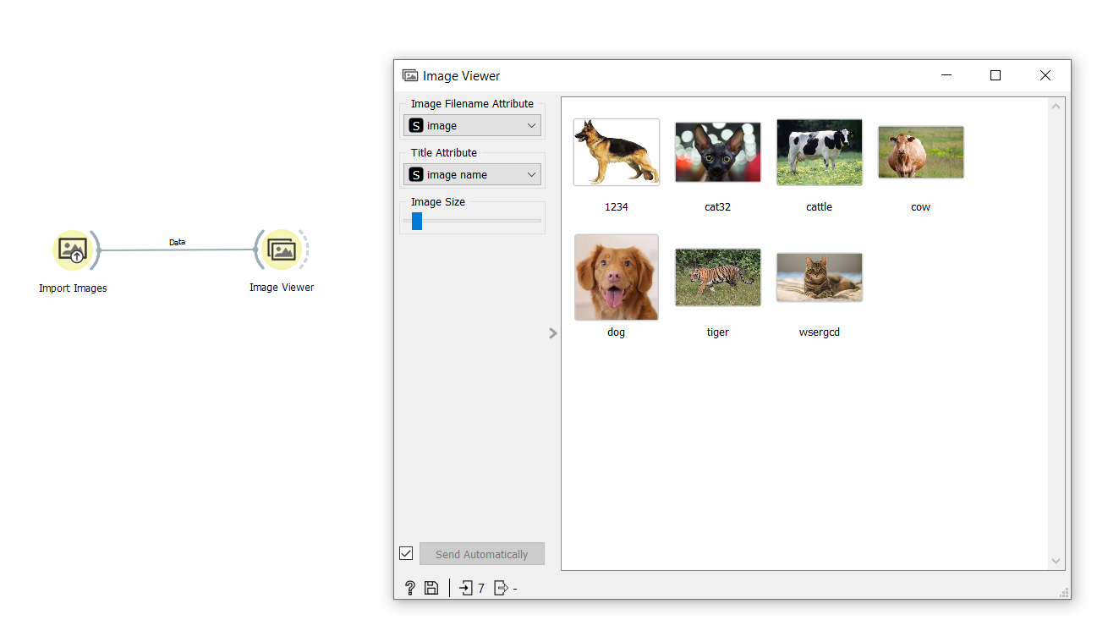
IMPLEMENTATION
Then I have imported the image folder with some animal pictures.

Slide 8
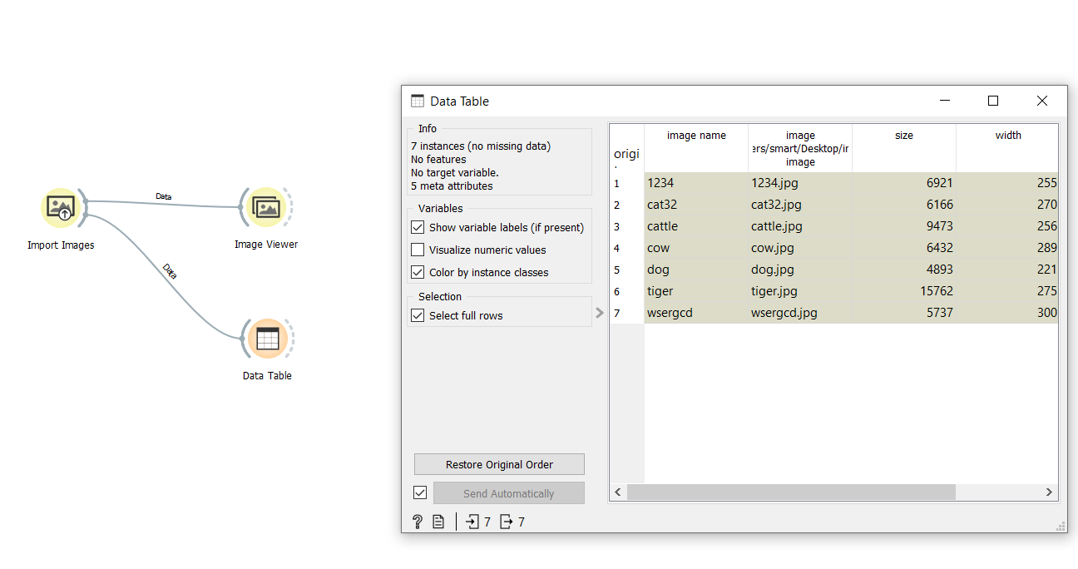
IMPLEMENTATION
If we see it using data table then we won’t get any useful information to prediction.

Slide 9
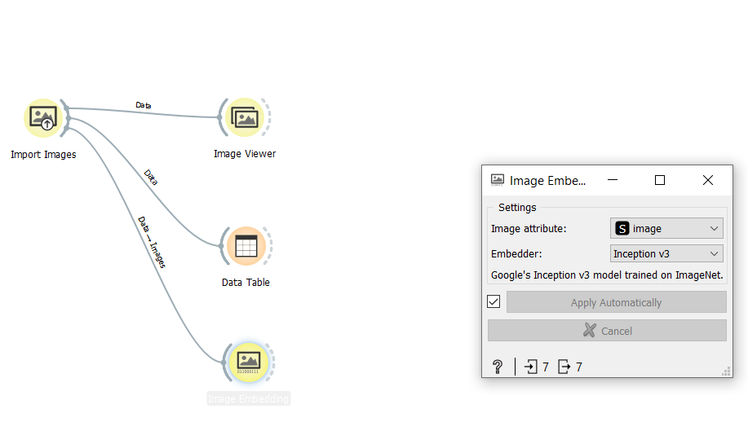
IMPLEMENTATION
After that, I have used Image Embedding to convert the data.

Slide 10
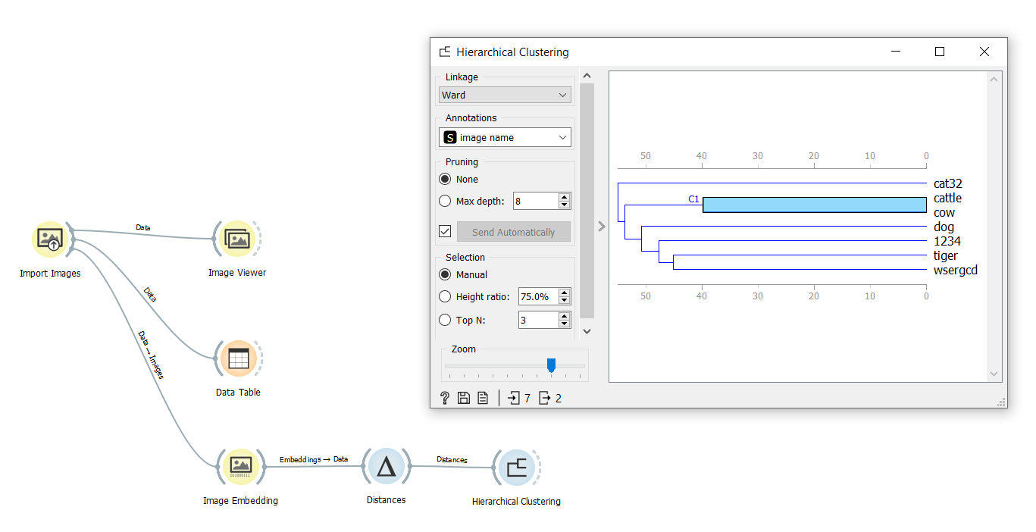
IMPLEMENTATION
After that, I have used Hierarchical Clustering method to visualize the clusters.
Among these clusters, I have selected cow cluster.

Slide 11
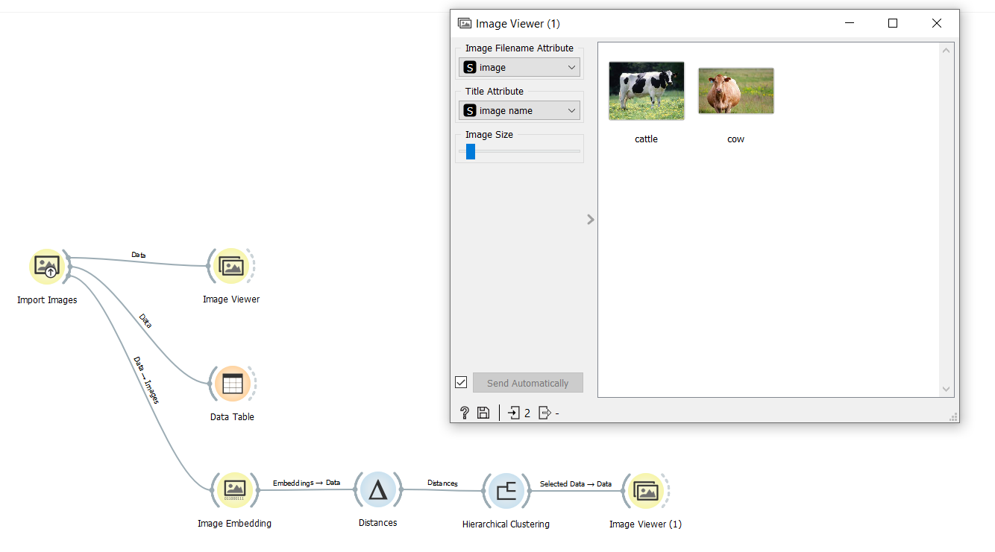
IMPLEMENTATION
Then, I have used Image Viewer to see the result we obtained using Hierarchical Clustering.

Slide 12
REFERENCES
Orange Website: http://orange.biolab.si/
Tutorials: https://www.javatpoint.com/orange-data-mining

Slide 13

THANK YOU

